Slide 1




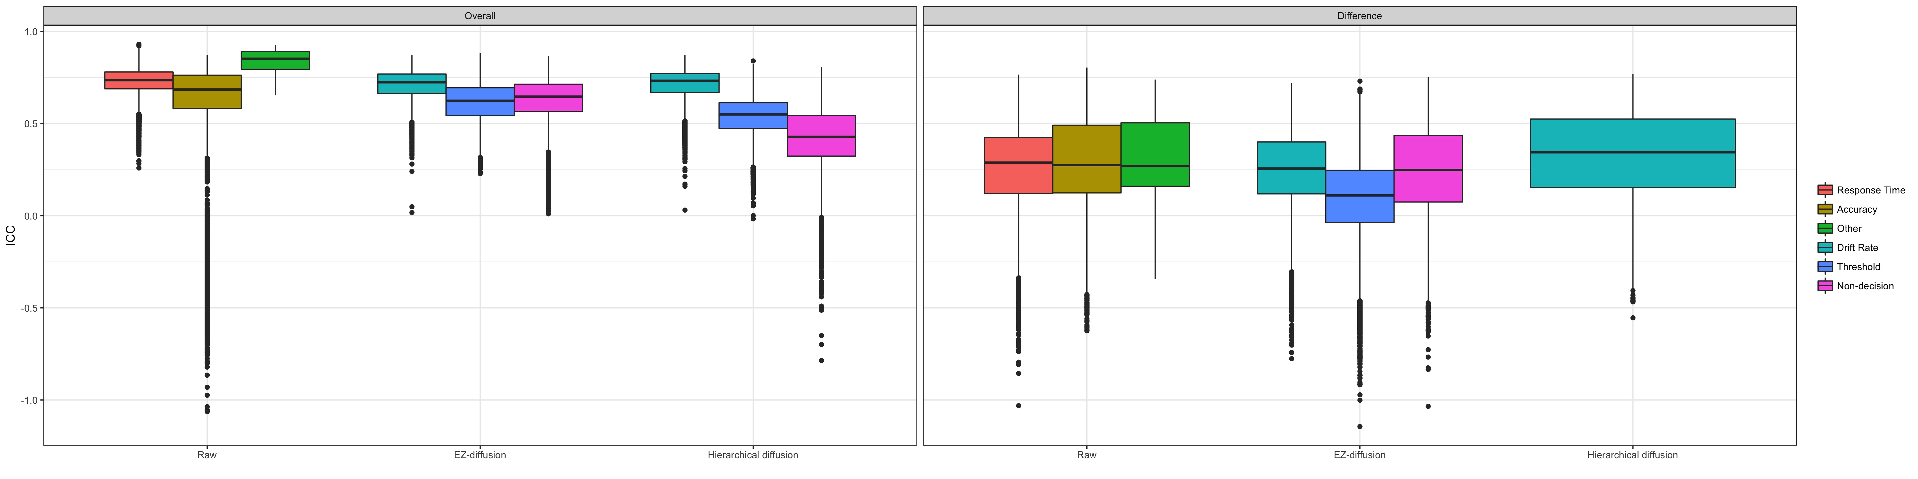
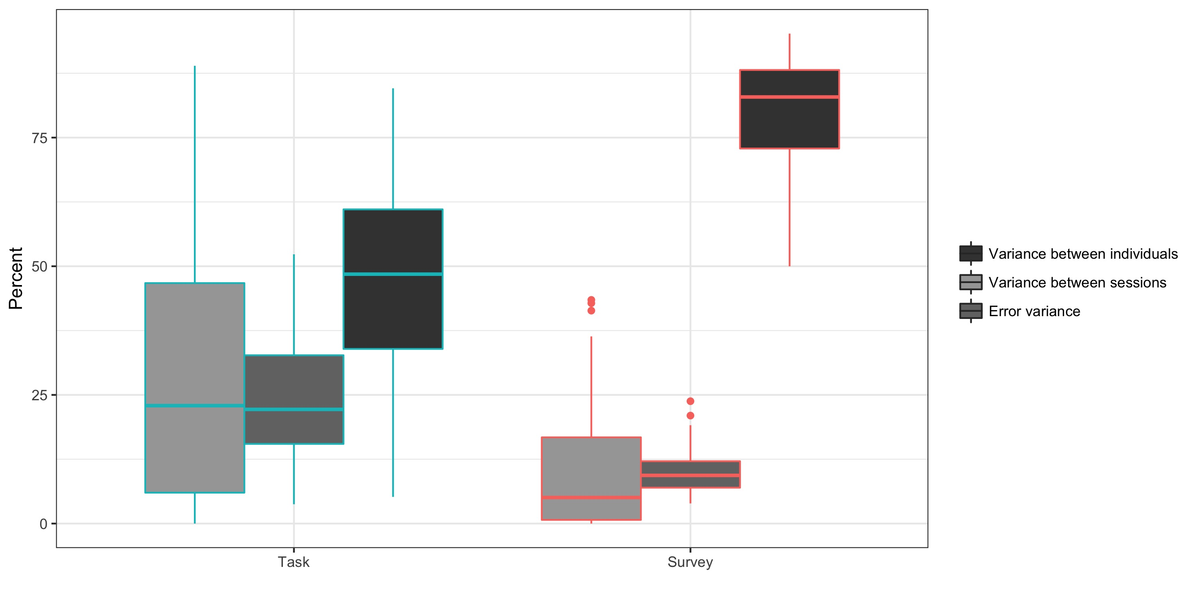
A large-scale analysis of test-retest reliabilities of self-regulation measures
A. Z. Enkavi¹, I. W. Eisenberg¹, P. G. Bissett¹, G. L. Mazza², D. P. Mackinnon², L. A. Marsch³, R.A. Poldrack¹
¹Department of Psychology, Stanford University, ²Department of Psychology, Arizona State University, ³Department of Psychiatry, Dartmouth College
Introduction
Literature review
New Data
Psychological literature is rich with measures of impulsivity, self-control, inhibition, delay discounting etc.
These measures are often assumed to capture trait-like individual differences without evaluating their stability over time.
We present a comprehensive literature review as well as novel analyses on a new large dataset containing both types of measures
Methods
Battery consisted of 37 cognitive tasks and 23 questionnaires putatively related to self-regulation https://expfactory.github.io/table.html
N=150 passed QC
Average retest delay = 115 days (range = 60 - 228 days)
ICC’s were used as the main retest reliability metric (no changes with Spearman or Pearson correlations)
Bootstrapped reliabilities (n = 1000)
Conclusions
DVs from tasks show larger variability and lower retest reliability compared to measures from surveys
This lower reliability is due to lower between subjects variance for cognitive task measures
Measures with low between subjects variance are not suitable for individual difference analyses
Drift diffusion parameters show similar reliability to RT and accuracy
Reliability
Reliability
Reliability
Reliability
ICC
References
Raw
EZ
diffusion
Hierarchical
diffusion
Raw
EZ
diffusion
Hierarchical
diffusion
Task
Survey
An interactive version of the literature review as well as a list of all the references can be found at goo.gl/gM7Pgr
Contact: A. Zeynep Enkavi <zenkavi@stanford.edu>
Notes:
-This study is an extension to our previous work in aging decision making
-The paradox here is: as people get older they face more complicated decisions in life.
-On the other hand, however, their cognitive abilities are declining.
-How then are they able to make “good” decisions? How are they “wise”?
-In our previous work we have shown that compensatory cognitive processes can account for this discrepancy.
-Namely, as fluid intelligence (your working memory, ability to solve complex problems on the spot) declines your crystallized intelligence (your accumulated knowledge) increases.
-In previous work, however, we have measured crystallized intelligence in a domain-general way like fluid intelligence. Using synonym, antonym and general knowledge tasks.
-This is different than our previous work in that we are focusing in a real-world domain: financial decision making and we are not only comparing old people to young people but have a sample of people from all age groups
-Furthermore we have expanded/improved/tailored our Gc measure to focus on this domain. So we have measured how financial literate people are and how much experience they have with financial products
-What is fico: well it is quiet an important number actually. It is people’s credit scores. Asked in renting an apartment, buying a car or a house, applying for a credit card etc
-With all of these implications this measure places our study somewhere between a lab experiment and a field study. So this data set is quiet unique.
-Given that fico is a historical measure older people are more likely to have higher scores: the more history you have the more likely you are to have a higher credit score, which implies and improvement in financial dm skill with age
-But keeping this paradox of decision making skills and aging in mind it is difficult to explain this rise in credit scores
-So here we combine what we know about compensatory cognitive abilities and real world measures
-As our statistical method we use SEM. A combination of path and mediation analysis. Since we have so many different measures this method allows us to measure underlying constructs and examine the relationships between them establishing causal paths
-What do we find:
-So the CCC mechanism explains this increase
-But we also have other personality and econ measures
-So what else predicts fico
-What we call economic phenotype here consists of measures often encountered in economics literature: relative risk attitude, delay discounting. Importantly we used multiple measures for these parameters as well.
-So dospert is a self-administered questionnaire consisting of questions asking how likely people judge themselves to engage in certain activities involving risk
-Lambda is the loss aversion parameter measured by an adaptive preference measurement task
-Using the same task we can also estimate alpha (the probability distortion measure) and sigma (the curvature of the value function – diminishing sensitivity)
-Beta and delta are measures of delay discounting (beta being the present bias and delta the discounting factor)
-And a personality scale: Regulatory-Focus-Questionnaire: RFQ is scale with 11 questions and two psychometrically distinct subscales (promotion and prevention). Here we focus on the prevention subscale. This measures people’s subjective histories of prevention success (A sample question is: How often did you obey rules and regulations that were established by your parents?”. Regulatory focus is the way an individual approaches goals and consists of two orientations. Prevention orientation involves sensitivity to the presence or absence of negative outcomes and is characterized by strategies of avoiding losses and approaching non-losses. People are sensitive to the absence or presence of negative outcomes (So we can see how this could be related to people’s risk attitudes and eventually their credit scores)

